Slide 1
Classification Evaluation Metrics
TIET, Patiala

Slide 2
Evaluation Metrics-Classification
The performance of the classification model is evaluated with a number of evaluation metrics. Some of the most commonly used are:
Confusion Metrics
Accuracy
Misclassification Rate
Precision
Recall/ True Positive Rate/ Sensitivity/ Hit Rate
F-β Score
Specificity
ROC Curve

Slide 3
Confusion Matrix
A confusion matrix is a table that is often used to describe the performance of a classification model (or "classifier") on a set of test data for which the true values are known.
It is a special kind of contingency table, with two dimensions ("actual" and "predicted"), and identical sets of "classes" in both dimensions
Each combination of dimension and class is a variable in the contingency table.
For instance, for a binary classification models, both dimensions have two classes 0 and 1 and hence there are four variables namely True Positive (TP), True Negative (TN), False Positive (FP), False Negative (FN).

Slide 4
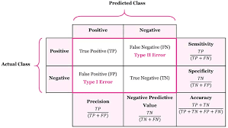
Confusion Matrix Contd….
True positives (TP): These are cases in which we predicted yes and the actually value is also yes.
True negatives (TN): These are cases in which we predicted no, and the actual value is also no.
False positives (FP): These are cases in which we predicted yes, but the actual value is no. (Also known as a "Type I error")
False negatives (FN): These are cases in which we predicted no, but the actual value is yes. (Also known as a "Type II error.")

Slide 5
Which error (Type I/Type II) is important?
Though, we want to minimize both False positive and False Negative errors. But, sometimes it is not possible to minimize both.
So, it depends upon the application that which error must be minimized.
For example, consider an application of classifying a patient as cancer patient (positive) or non-cancer patient (negative). In this application, diagnosing a cancer patient as healthy (False negative) is more important as compared to diagnosing a healthy patient as cancer (False Positive). So, False Negative must be minimized.
Consider another application of classifying emails as spam (positive) or ham (negative). In this application, classifying a ham email as spam (False Positive) is more important than spam as ham (False Negative). So, False Positive must be minimized.

Slide 6
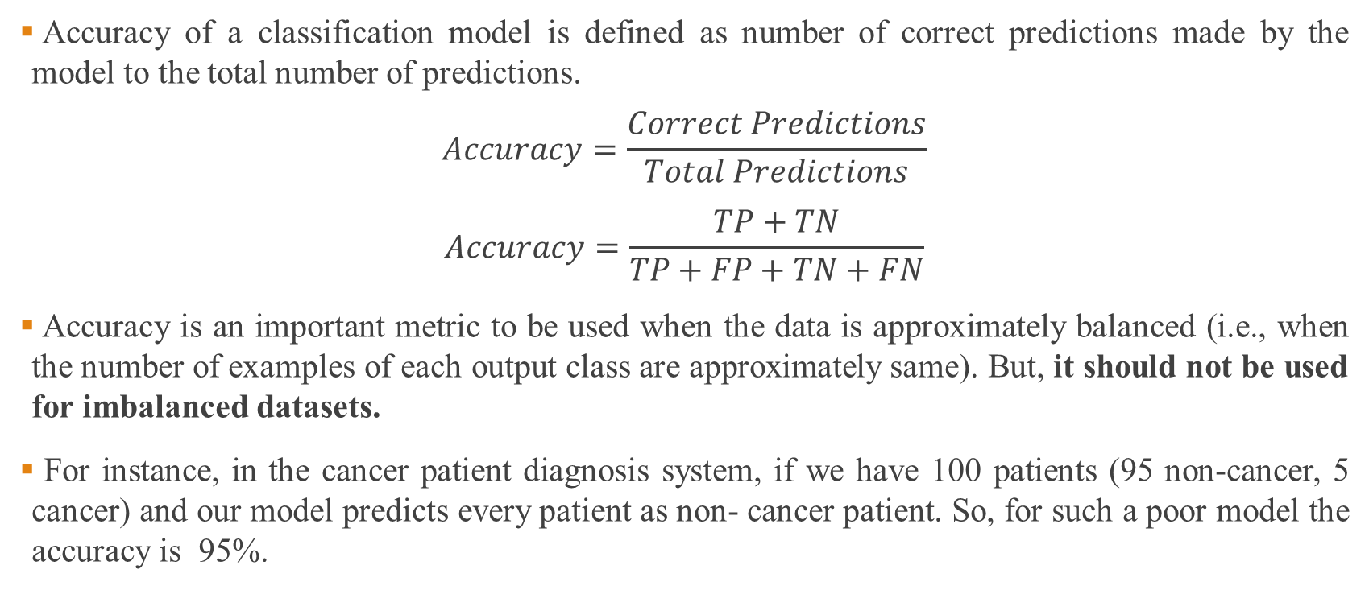
Accuracy
Accuracy of a classification model is defined as number of correct predictions made by the model to the total number of predictions.
$$Accuracy=\frac{Correct Predictions}{Total Predictions}$$
$$Accuracy=\frac{TP+TN}{TP+FP+TN+FN}$$
Accuracy is an important metric to be used when the data is approximately balanced (i.e., when the number of examples of each output class are approximately same). But, it should not be used for imbalanced datasets.
For instance, in the cancer patient diagnosis system, if we have 100 patients (95 non-cancer, 5 cancer) and our model predicts every patient as non- cancer patient. So, for such a poor model the accuracy is 95%.

Slide 7
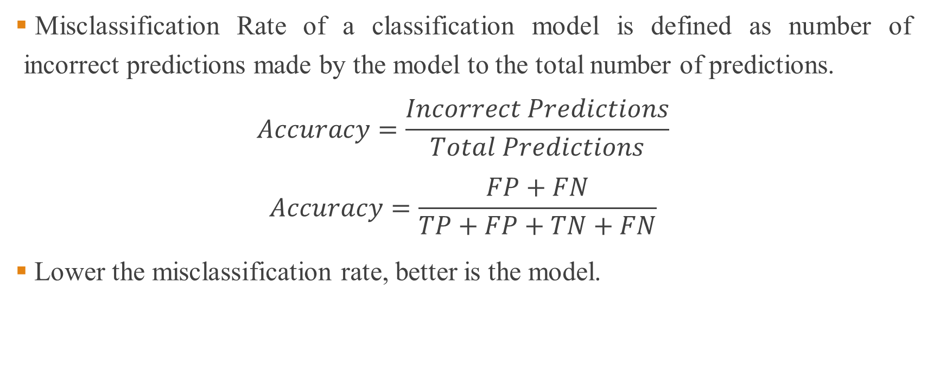
Misclassification Rate
Misclassification Rate of a classification model is defined as number of incorrect predictions made by the model to the total number of predictions.
$$Accuracy=\frac{Incorrect Predictions}{Total Predictions}$$
$$Accuracy=\frac{FP+FN}{TP+FP+TN+FN}$$
Lower the misclassification rate, better is the model.

Slide 8
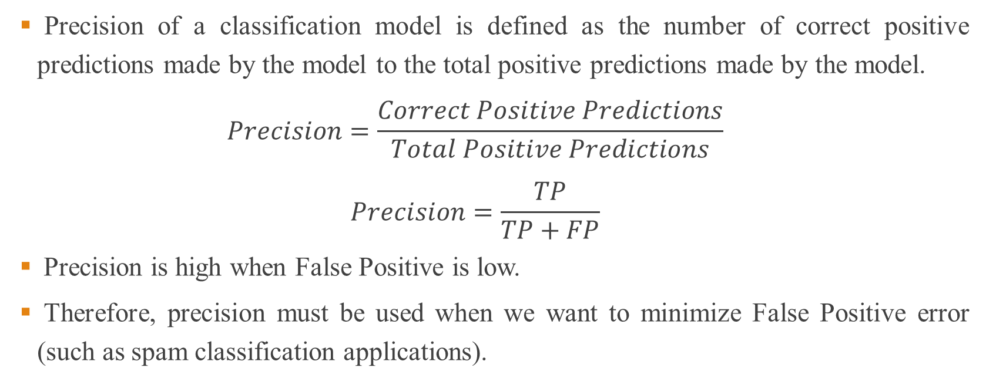
Precision
Precision of a classification model is defined as the number of correct positive predictions made by the model to the total positive predictions made by the model.
$$Precision=\frac{Correct Positive Predictions}{Total Positive Predictions}$$
$$Precision=\frac{TP}{TP+FP}$$
Precision is high when False Positive is low.
Therefore, precision must be used when we want to minimize False Positive error (such as spam classification applications).

Slide 9
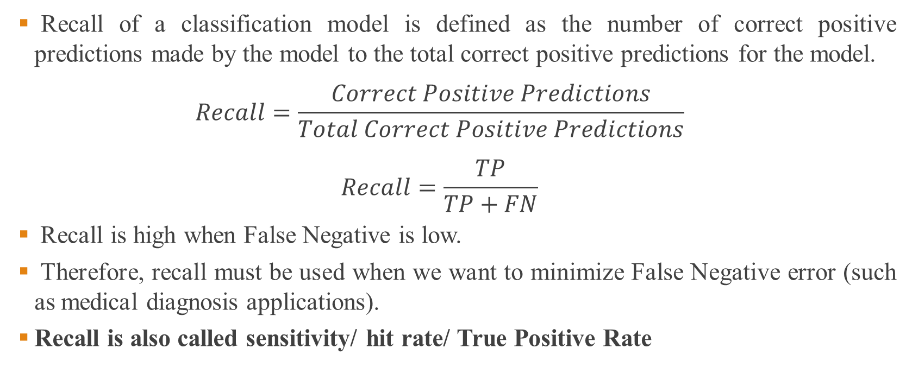
Recall
Recall of a classification model is defined as the number of correct positive predictions made by the model to the total correct positive predictions for the model.
$$Recall=\frac{Correct Positive Predictions}{Total Correct Positive Predictions}$$
$$Recall=\frac{TP}{TP+FN}$$
Recall is high when False Negative is low.
Therefore, recall must be used when we want to minimize False Negative error (such as medical diagnosis applications).
Recall is also called sensitivity/ hit rate/ True Positive Rate

Slide 10
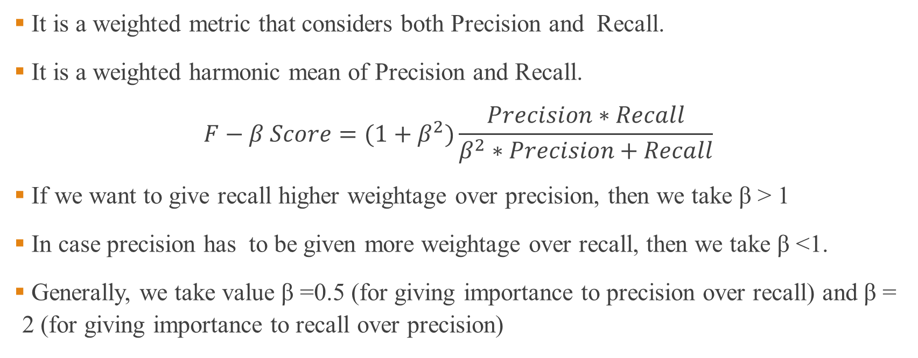
F-β Score
It is a weighted metric that considers both Precision and Recall.
It is a weighted harmonic mean of Precision and Recall.
$$F−β Score=(1+β^{2})\frac{Precision∗Recall}{β^{2}∗Precision+Recall}$$
If we want to give recall higher weightage over precision, then we take β > 1
In case precision has to be given more weightage over recall, then we take β <1.
Generally, we take value β =0.5 (for giving importance to precision over recall) and β = 2 (for giving importance to recall over precision)

Slide 11
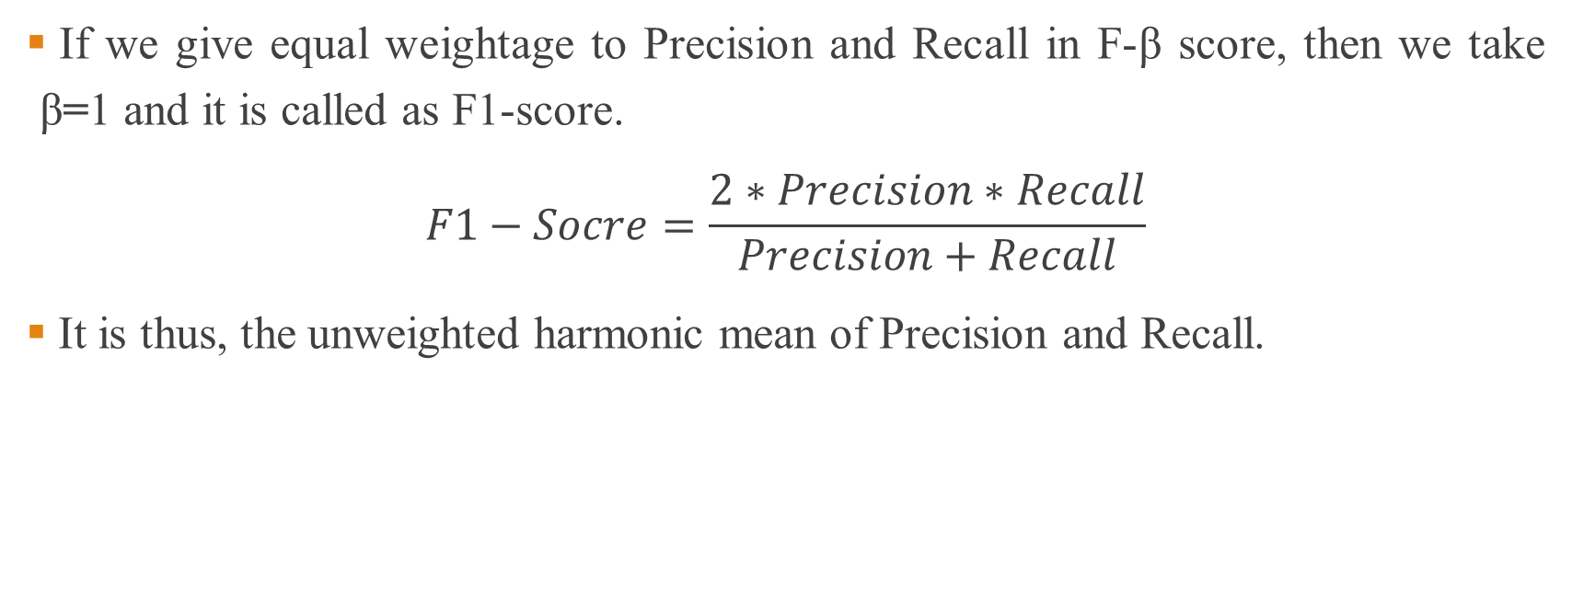
F1-Score
If we give equal weightage to Precision and Recall in F-β score, then we take β=1 and it is called as F1-score.
$$F1−Socre=\frac{2∗Precision∗Recall}{Precision+Recall}$$
It is thus, the unweighted harmonic mean of Precision and Recall.

Slide 12
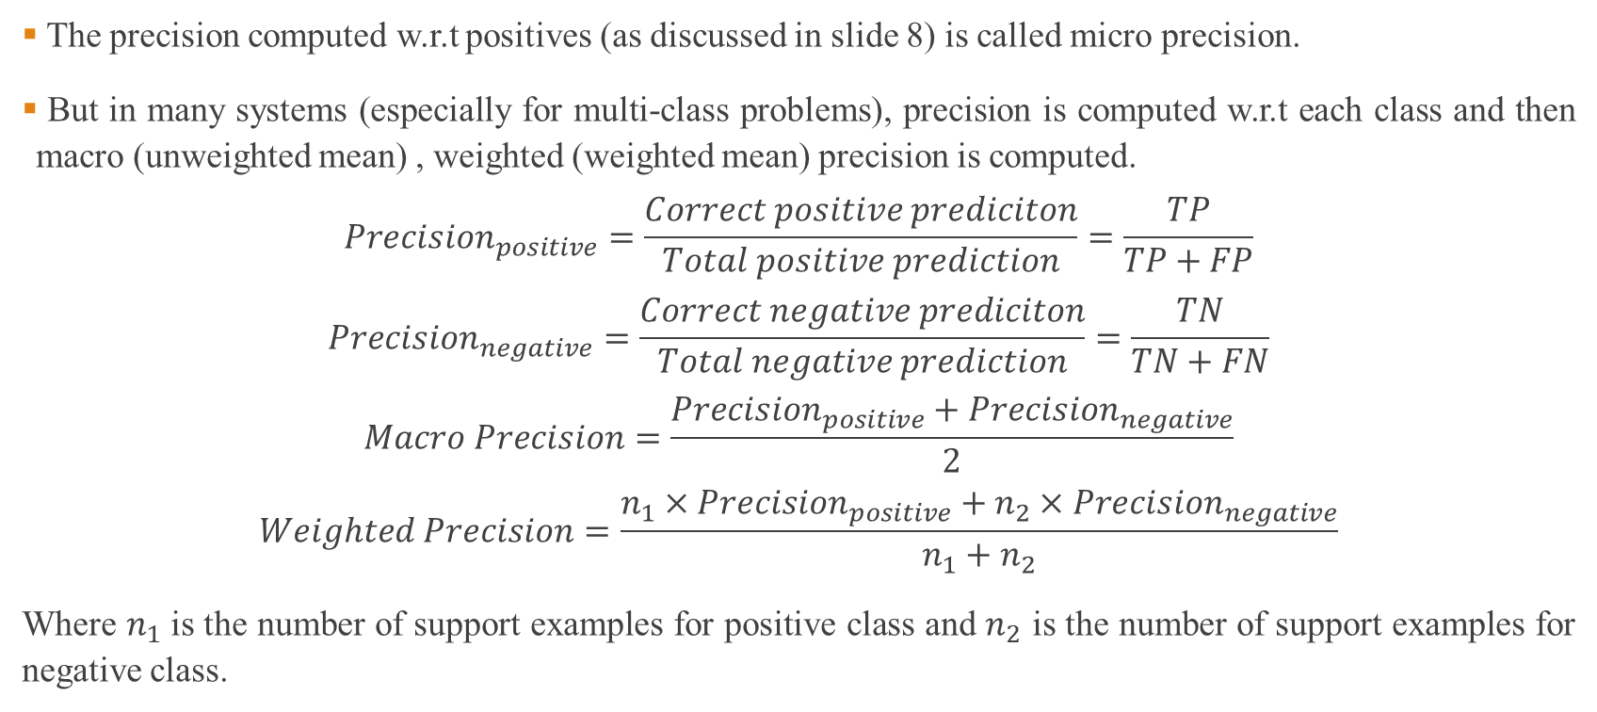
Macro & Weighted Precision
The precision computed w.r.t positives (as discussed in slide 8) is called micro precision.
But in many systems (especially for multi-class problems), precision is computed w.r.t each class and then macro (unweighted mean) , weighted (weighted mean) precision is computed.
$$Precision_{positive}=\frac{Correct positive prediciton}{Total positive prediction}=\frac{TP}{TP+FP}$$
$$Precision_{negative}=\frac{Correct negative prediciton}{Total negative prediction}=\frac{TN}{TN+FN}$$
$$Macro Precision=\frac{Precision_{positive}+Precision_{negative}}{2}$$
$$Weighted Precision=\frac{n_{1}×Precision_{positive}+n_{2}×Precision_{negative}}{n_{1}+n_{2}}$$
Where $n_{1}$is the number of support examples for positive class and $n_{2}$ is the number of support examples for negative class.

Slide 13
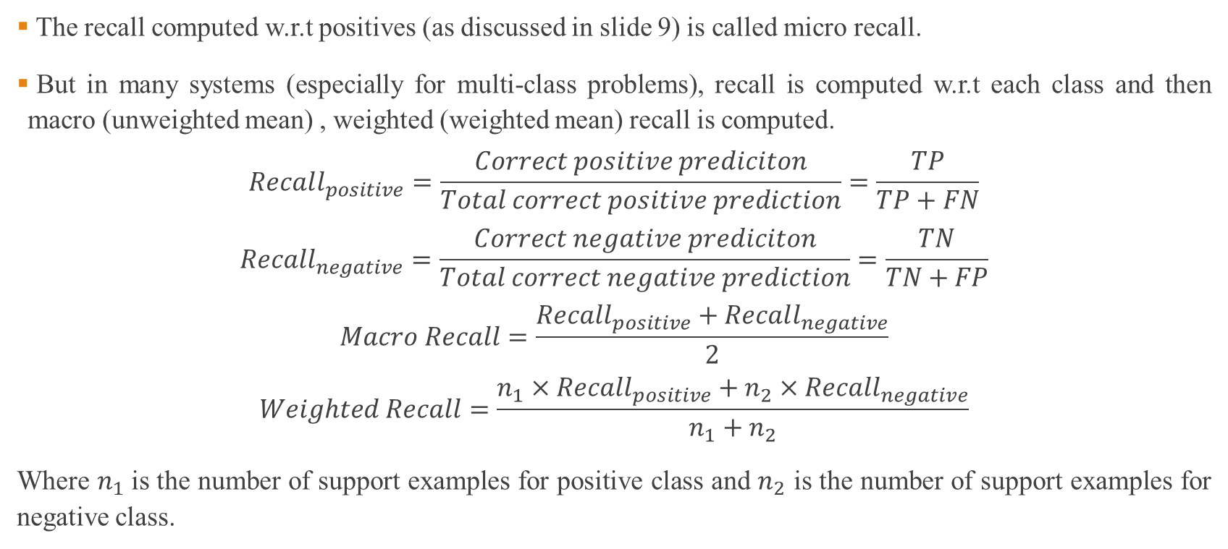
Macro & Weighted Recall
The recall computed w.r.t positives (as discussed in slide 9) is called micro recall.
But in many systems (especially for multi-class problems), recall is computed w.r.t each class and then macro (unweighted mean) , weighted (weighted mean) recall is computed.
$$Recall_{positive}=\frac{Correct positive prediciton}{Total correct positive prediction}=\frac{TP}{TP+FN}$$
$$Recall_{negative}=\frac{Correct negative prediciton}{Total correct negative prediction}=\frac{TN}{TN+FP}$$
$$Macro Recall=\frac{Recall_{positive}+Recall_{negative}}{2}$$
$$Weighted Recall=\frac{n_{1}×Recall_{positive}+n_{2}×Recall_{negative}}{n_{1}+n_{2}}$$
Where $n_{1}$is the number of support examples for positive class and $n_{2}$ is the number of support examples for negative class.

Slide 14
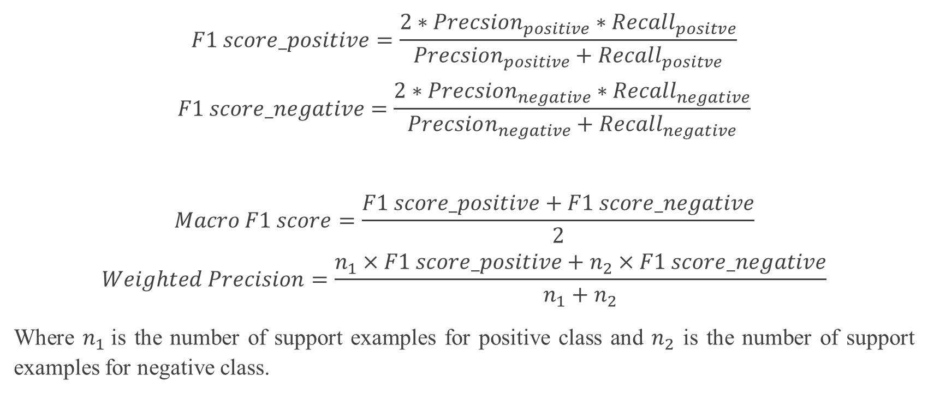
Macro & Weighted F1-Score
$$F1 score_positive=\frac{2∗Precsion_{positive}∗Recall_{positve}}{Precsion_{positive}+Recall_{positve}}$$
$$F1 score_negative=\frac{2∗Precsion_{negative}∗Recall_{negative}}{Precsion_{negative}+Recall_{negative}}$$
$$Macro F1 score=\frac{F1 score_positive+F1 score_negative}{2}$$
$$Weighted Precision=\frac{n_{1}×F1 score_positive+n_{2}×F1 score_negative}{n_{1}+n_{2}}$$
Where $n_{1}$is the number of support examples for positive class and $n_{2}$ is the number of support examples for negative class.

Slide 15
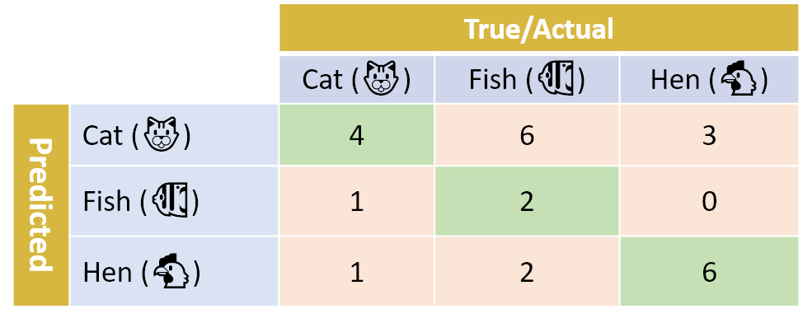
Numerical Example
For the confusion matrix, compute
Accuracy
Precision for each class, Macro Precision and Weighted Precision
Recall for each class, Macro Recall and Weighted Recall

Slide 16
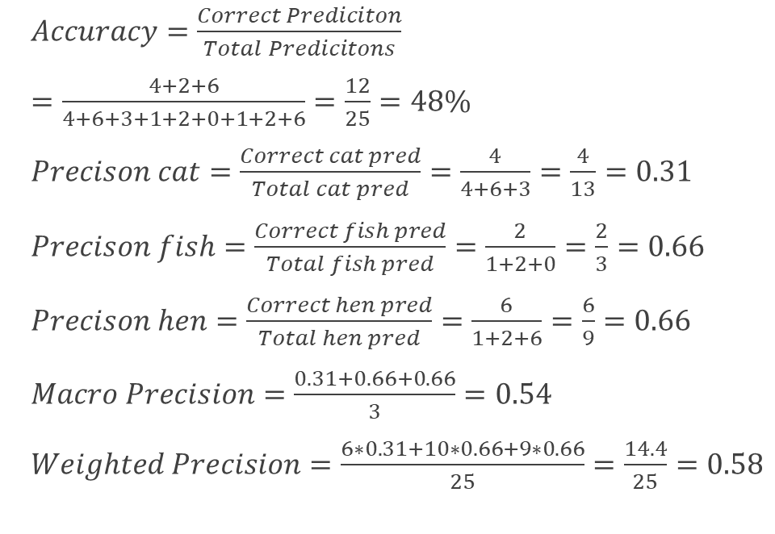
Numerical Example-Solution
$Accuracy=\frac{Correct Prediciton}{Total Predicitons}$
$=\frac{4+2+6}{4+6+3+1+2+0+1+2+6}=\frac{12}{25}=48\%$
$Precison cat=\frac{Correct cat pred}{Total cat pred}=\frac{4}{4+6+3}=\frac{4}{13}=0.31$
$Precison fish=\frac{Correct fish pred}{Total fish pred}=\frac{2}{1+2+0}=\frac{2}{3}=0.66$
$Precison hen=\frac{Correct hen pred}{Total hen pred}=\frac{6}{1+2+6}=\frac{6}{9}=0.66$
$Macro Precision=\frac{0.31+0.66+0.66}{3}=0.54$
$Weighted Precision=\frac{6∗0.31+10∗0.66+9∗0.66}{25}=\frac{14.4}{25}=0.58$

Slide 17
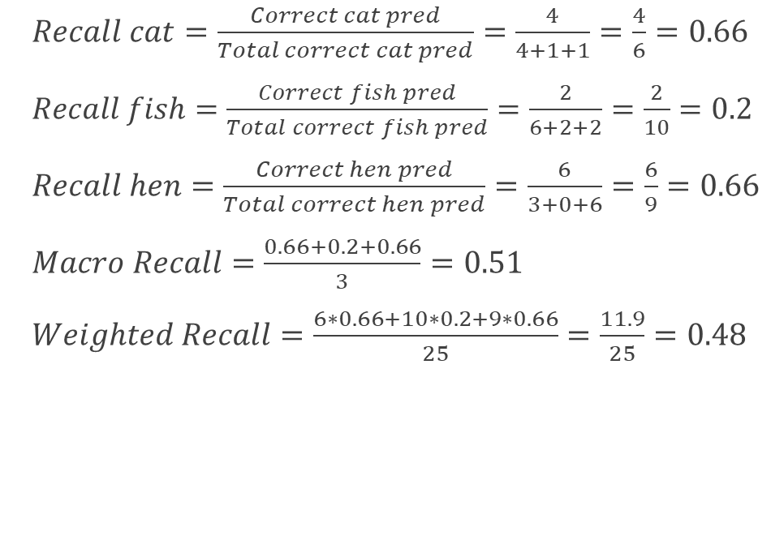
Numerical Example-Solution
$Recall cat=\frac{Correct cat pred}{Total correct cat pred}=\frac{4}{4+1+1}=\frac{4}{6}=0.66$
$Recall fish=\frac{Correct fish pred}{Total correct fish pred}=\frac{2}{6+2+2}=\frac{2}{10}=0.2$
$Recall hen=\frac{Correct hen pred}{Total correct hen pred}=\frac{6}{3+0+6}=\frac{6}{9}=0.66$
$Macro Recall=\frac{0.66+0.2+0.66}{3}=0.51$
$Weighted Recall=\frac{6∗0.66+10∗0.2+9∗0.66}{25}=\frac{11.9}{25}=0.48$

Slide 18
Sensitivity and Specificity
The terms "sensitivity" and "specificity" were introduced by American biostatistician Jacob. It is widely used in medical diagnosis system.
Sensitivity (as discussed earlier) is the true positive rate or recall.
Specificity is True Negative rate that measures the proportion of negatives that are correctly identified.
In medical diagnosis systems, both are important. As sensitivity tells that how many sick patients are correctly identified as sick and specificity tells that how many healthy patients are identified as healthy.
Thus, if a test's sensitivity is 97% and its specificity is 92%, its rate of false negatives is 3% and its rate of false positives is 8%.

Slide 19
ROC Curve
The Receiver Operator Characteristic (ROC) curve is an evaluation metric for binary classification problems.
. It is a probability curve that plots the TPR against FPR (FPR=1-Specificity) at various threshold values.
The Area Under the Curve (AUC) is the measure of the ability of a classifier to distinguish between classes and is used as a summary of the ROC curve.
When AUC = 1, then the classifier is able to perfectly distinguish between all the Positive and the Negative class points correctly.
If, however, the AUC had been 0, then the classifier would be predicting all Negatives as Positives, and all Positives as Negatives.

Slide 20
ROC Curve (Contd…)
When 0.5<AUC<1, there is a high chance that the classifier will be able to distinguish the positive class values from the negative class values. This is so because the classifier is able to detect more numbers of True positives and True negatives than False negatives and False positives.

Slide 21
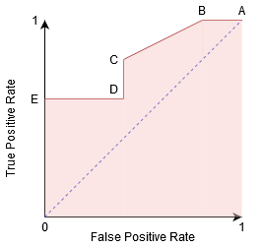
ROC Curve (Contd…)
In a ROC curve, a higher X-axis value indicates a higher number of False positives than True negatives. While a higher Y-axis value indicates a higher number of True positives than False negatives.
So, the choice of the threshold depends on the ability to balance between False positives and False negatives.
Point A is where the Sensitivity is the highest and Specificity the lowest. This means all the Positive class points are classified correctly and all the Negative class points are classified incorrectly.

Slide 22
ROC Curve (Contd…)
Although Point B has the same Sensitivity as Point A, it has a higher Specificity. Meaning the number of incorrectly Negative class points is lower compared to the previous threshold. This indicates that this threshold is better than the previous one.
Between points C and D, the Sensitivity at point C is higher than point D for the same Specificity. This means, for the same number of incorrectly classified Negative class points, the classifier predicted a higher number of Positive class points.
Point E is where the Specificity becomes highest. Meaning there are no False Positives classified by the model. The model can correctly classify all the Negative class points!

